Slide 1
Similarity between San Francisco and Los Angeles - The battle of neighborhoods
Yujin Cho
May 3rd, 2021

Slide 2
San Francisco and Los Angeles are culturally diverse.
I. Introduction
Diverse population:
San Francisco: 34 % Asian, 15 % Latinos
Los Angeles: 50 % Latinos, 11 % Asians
Visitors from all over the world
San Francisco: 26 million visitors in 2019
Los Angeles: 50 million visitors in 2019
The diversity is also reflected to cultural towns, such as Koreatown, China town, Little Tokyo, or Little Italy.
In this project, we analyzed the categories of the restaurants to understand the diversity of the two cities and how they are distributed.
This would be beneficial to people who are looking for a certain cultural food, instead of a specific restaurants, tourists, or people who would like to open a business related to these culture.

Slide 3
Venues are from Foursquare and a new label ‘Region’ was assigned to each restaurant.
II. Data
Raw data:
List of the neighborhoods are from Wikipedia (San Francisco) and a website (http://www.laalmanac.com/cities/ci93.php; Los Angeles).
Search area: 500m radius, the number of the venues: 100
Data cleaning:
Only selected venues that have the word ‘restaurant’ in the category.
Some categories are too specific, so reassigned it to a bigger category.
e.g. Sushi Restaurant -> Japanese Restaurant
Assigned the region based on the origin of the foods. 11 categories in total
South/East/West Asia, North/Latin America, South/West/North/East Europe, East Africa, Others

Slide 4
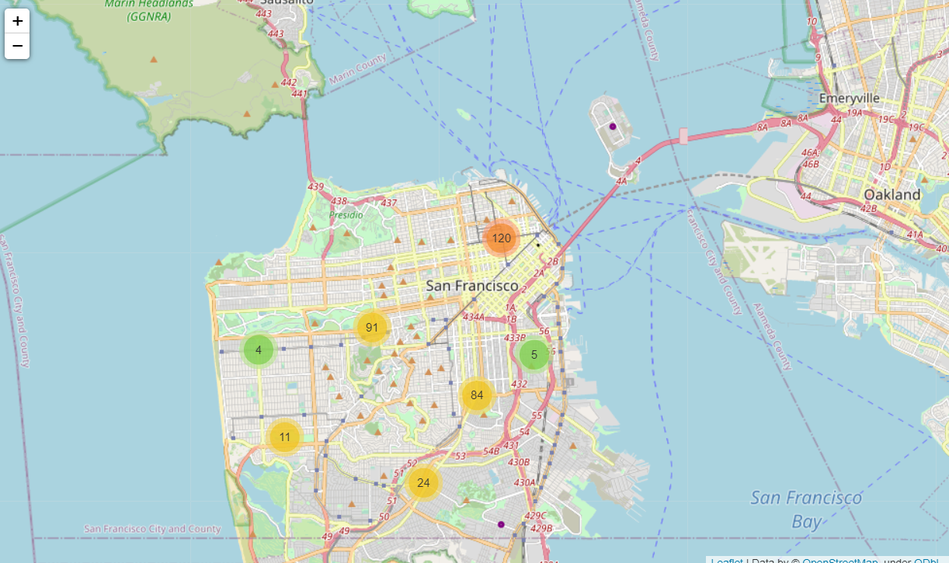
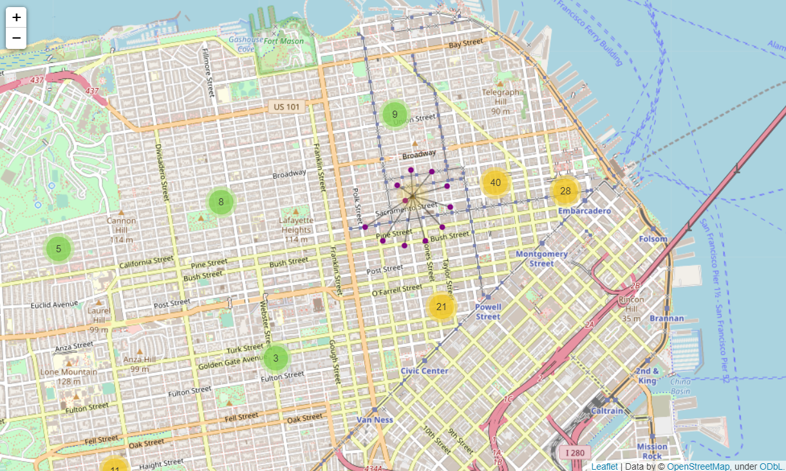
Folium map with marker clusters display where the individual restaurants are.
II. Data Analysis; San Francisco
Zoom-in
Purple dots: each restaurant
When clicking the dots, you can find the name of the restaurant.

Slide 5
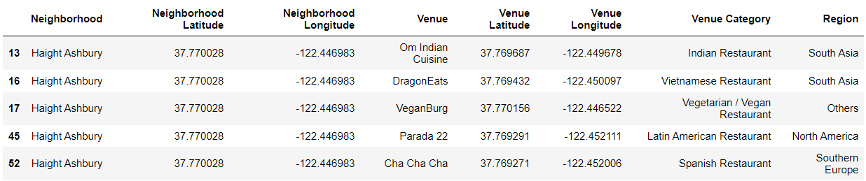
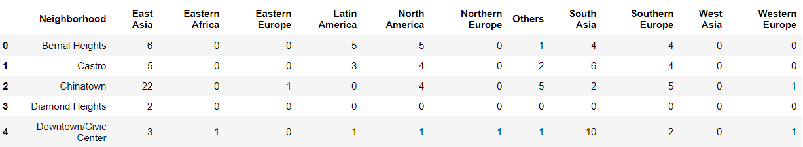
Assigned a new label, Region, and count the number of restaurants in the category.
II. Data Analysis; San Francisco
New label
Count the number of restaurants for each neighborhood

Slide 6
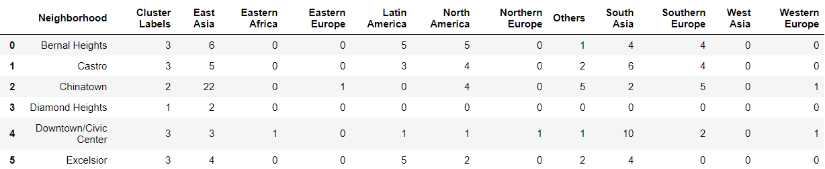
K-Means clustering is useful to find similar neighborhoods.
II. Data Analysis; San Francisco
The number of cluster: 5
Added a new column with the cluster label to the data frame.
Now let’s take a look at each cluster.
Cluster label from 0 to 4.
The same number means they are ‘similar’ neighborhoods.

Slide 7
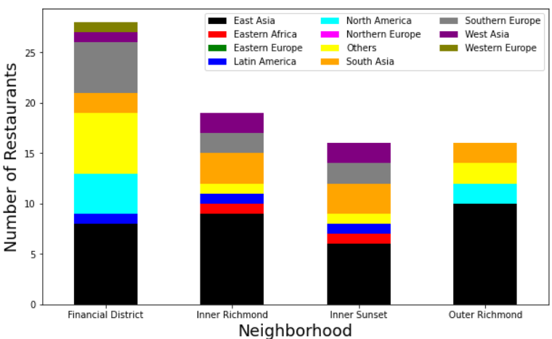
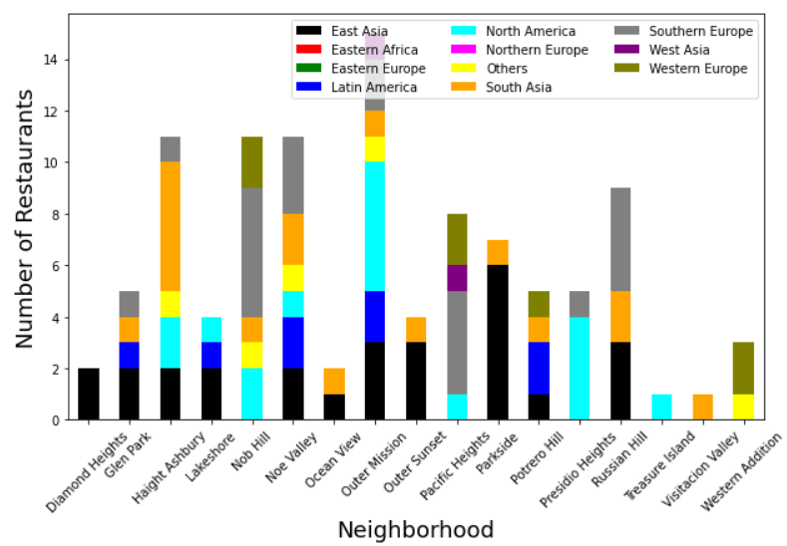
It is easy to see which category is popular from a bar graph.
II. Data Analysis; San Francisco
Cluster 0
Cluster 1
East Asian foods (black) are the most popular in Cluster 0
East Asian(black), South European(grey), North American(cyan) are almost equally popular in Cluster 1

Slide 8
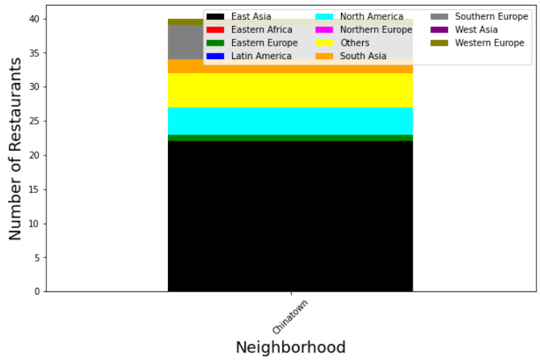
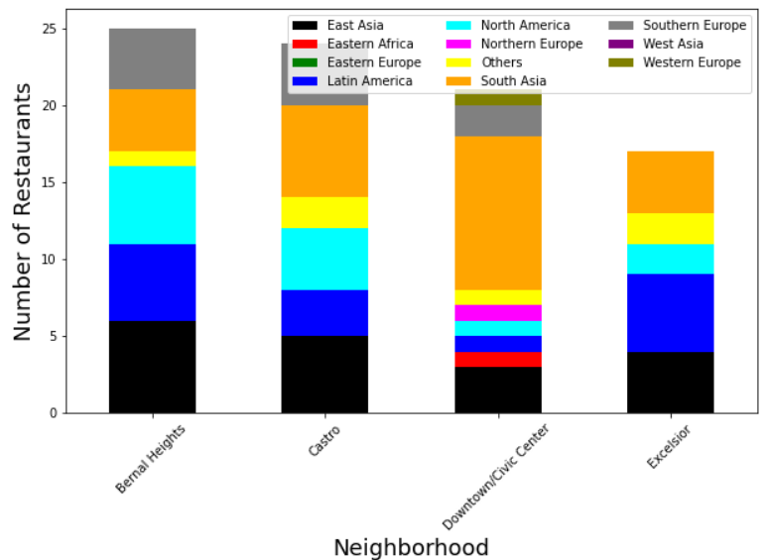
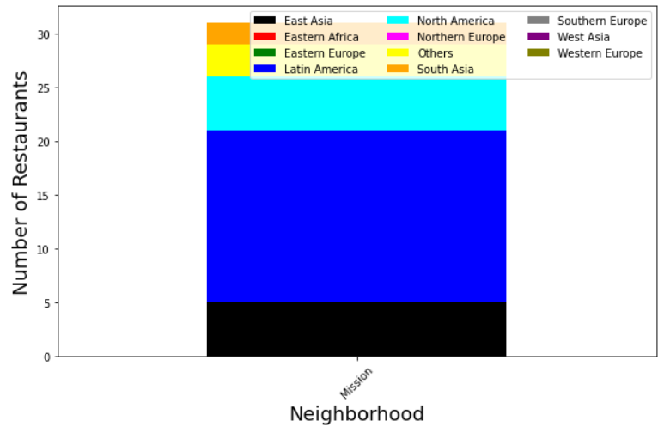
It is easy to see which category is popular from a bar graph.
II. Data Analysis; San Francisco
Cluster 2
Cluster 3
Cluster 4
Cluster 2: East Asian foods are much more popular than the others.
Compared to Cluster 0, the percentage of East Asian foods are much higher and it also has East European foods as well.
Cluster 3: More Latin American food(blue) compared to other categories.
Cluster 4: Latin American foods are the most popular ones.

Slide 9
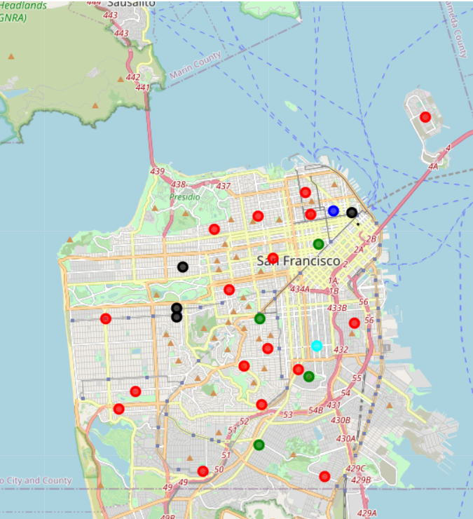
Map with cluster labels helps to geographically locate where those neighborhoods are.
II. Data Analysis; San Francisco
Cluster | Color
0 | Black
1 | Red
2 | Blue
3 | Green
4 | Cyan
In Cluster 0, 1, 2, East Asian foods are the most popular. These neighborhoods are distributed homogeneously across the city.
Blue dot is China town which has East Asian foods particularly more than the others.
Cyan dot is the Mission district, the center of Mexican culture. Latin American foods are the most popular.

Slide 10
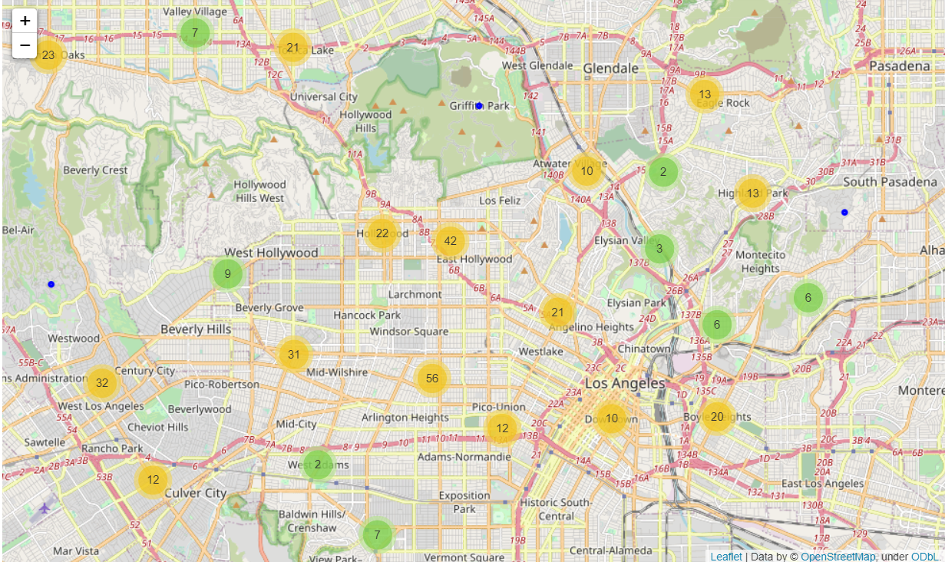
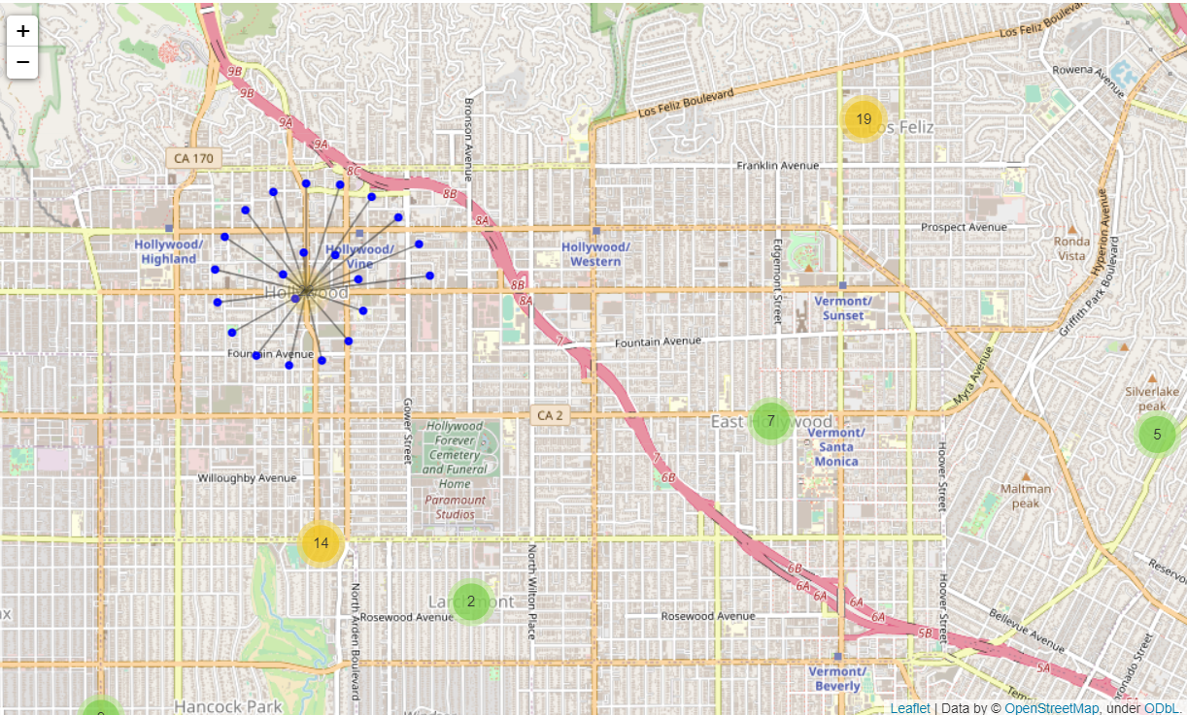
Now, let’s repeat the same analysis for Los Angeles.
II. Data Analysis; Los Angeles
There are 584 restaurants in the city of Los Angeles.

Slide 11
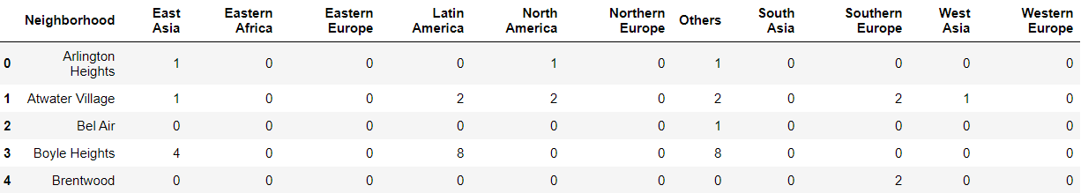
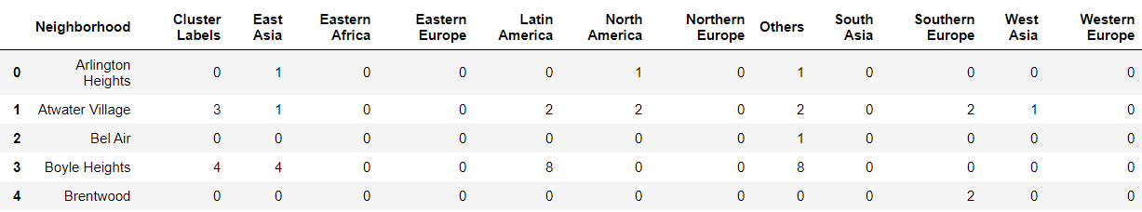
After data cleaning, K-means clustering was used to find the similar neighborhoods.
II. Data Analysis; Los Angeles
I assigned the new label ‘Region’, as in the previous slides and count the number of the restaurants of each region.
K-means clustering
Number of clusters: 5
New label

Slide 12
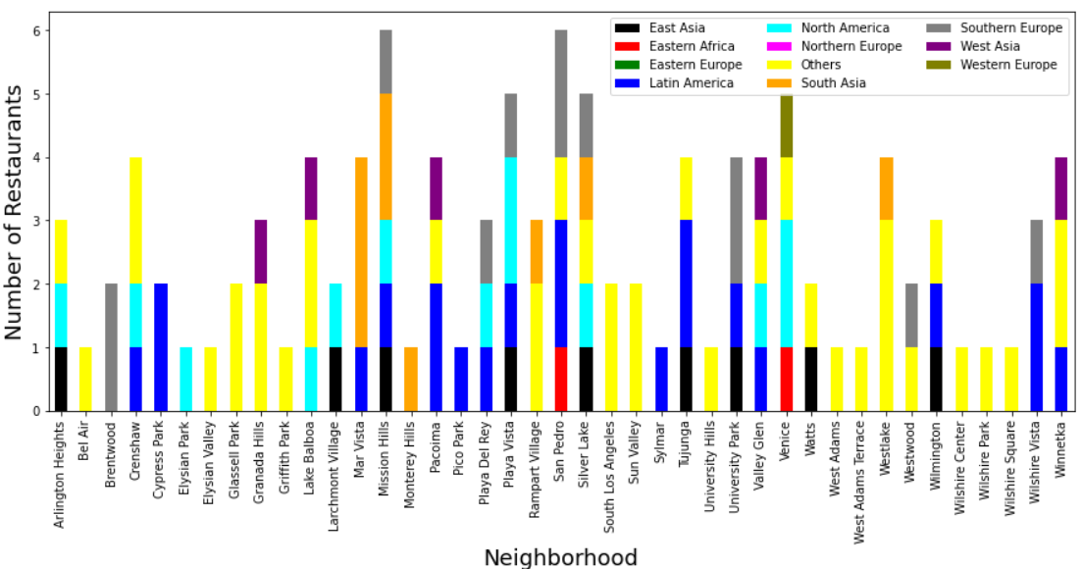
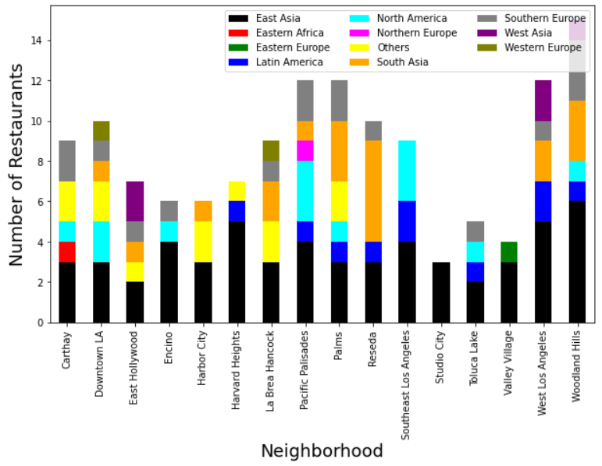
Let’s take a closer look at each cluster.
II. Data Analysis; Los Angeles
Cluster 0
Cluster 1
Cluster 0: Restaurants in the ‘Others’ category are the most popular. The second popular food is Latin American foods.
Cluster 1: East and South Asian foods are popular.

Slide 13
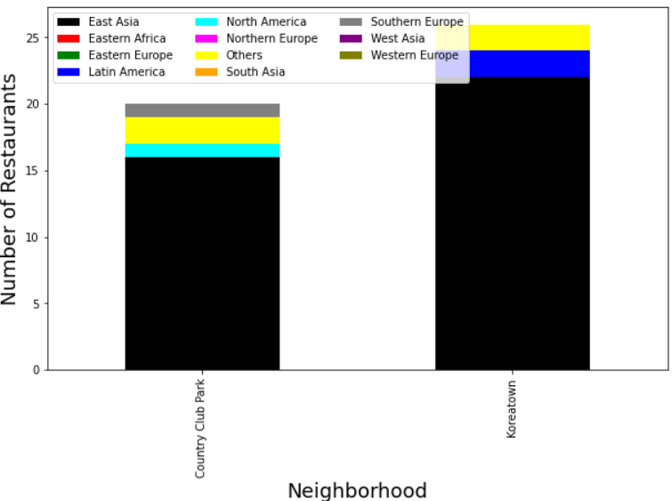
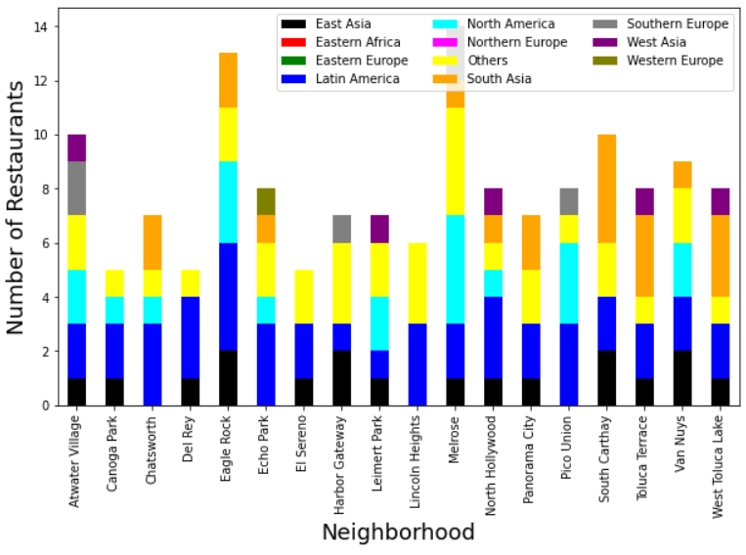
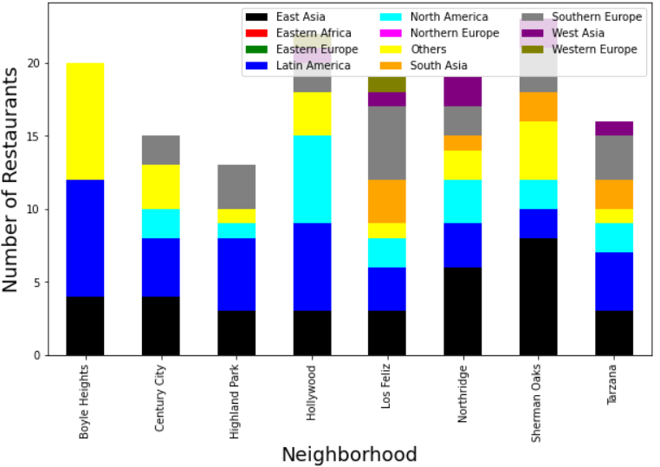
Let’s take a closer look at each cluster.
II. Data Analysis; Los Angeles
Cluster 2
Cluster 3
Cluster 4
Cluster 2: East Asian food category is highly dominant
Cluster 3 and 4: Latin American foods are the most popular ones. The second popular category is the ‘others’ in Cluster 3 and East Asians in Cluster 4.

Slide 14
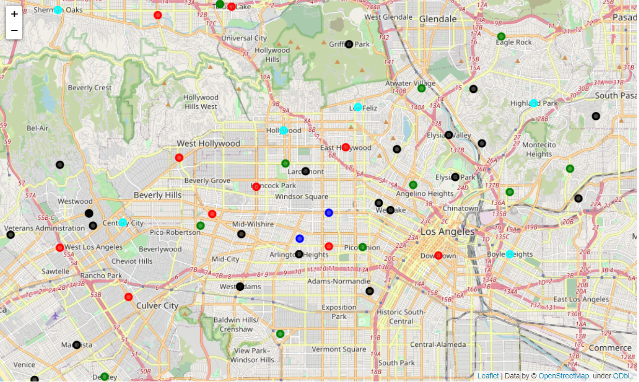
East Asian and Latin American restaurants are distributed quite evenly.
II. Data Analysis; Los Angeles
Cluster | Color
0 | Black
1 | Red
2 | Blue
3 | Green
4 | Cyan
The most popular category in Cluster 0 (black dot) is the ‘Others’. I will discuss this later.
Blue dots (Cluster 2) are located in the cultural centers; Koreatown and Country Club park
Cluster 3 and 4 are popular for Latin American foods.

Slide 15
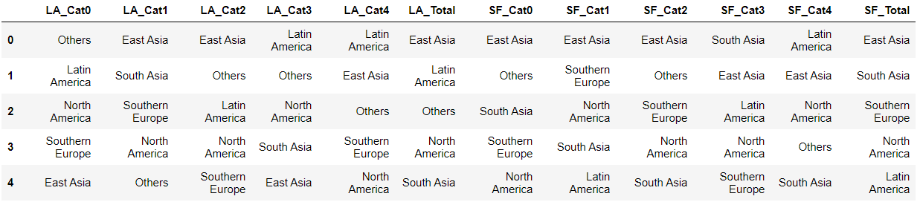
San Francisco and Los Angeles are diverse.
II. Data Analysis; Comparison
In both San Francisco and Los Angeles, East Asian foods are the most popular.
San Francisco has more percentage of East Asian restaurants (30%) while Los Angeles has comparable percentages for East Asian (26%) and Latin American restaurants (18%).
The table of the percentage is given in the report.

Slide 16
By looking at the categories foods, we can get insights into the cultural diversity.
III. Discussion
In Los Angeles, as mentioned earlier, the population of Latinos is large and the second largest is Asians. This is reflected in the food categories as well. East Asians and Latin American foods are the two most popular foods.
In San Francisco, Asian population is much higher than in Los Angeles. Therefore, there are a lot more East Asian foods, distributed uniformly across the city.
This means..
It is not difficult to find East Asian foods wherever you go in San Francisco.
To have more options for East Asian or Latin American foods, you can go to the cultural centers, as marked in the maps earlier.
If you want to open a business related to those cultures, this map would be useful to choose a location.
In the next page, I will discuss points that can be improved in the future.

Slide 17
Future improvement with the analysis.
III. Discussion
The filter keyword ‘restaurant’ in the beginning may not capture all restaurants.
E.g. Poke Place is a Japanese restaurant, but it was not included in this analysis.
The number of missing data is small. Therefore, it would not be a major problem, but if you want to be precise, this has to be corrected manually.
‘Others’ category
Some foods are hard to pick a region, such as fast food, seafood, vegan. Some restaurants have category, simply ‘Restaurant’.
To fix this, we would need to look at the menus and put them in the right category.

